Slide 1



A Special Guide to
Skin Cancer
Prevention

Slide 2

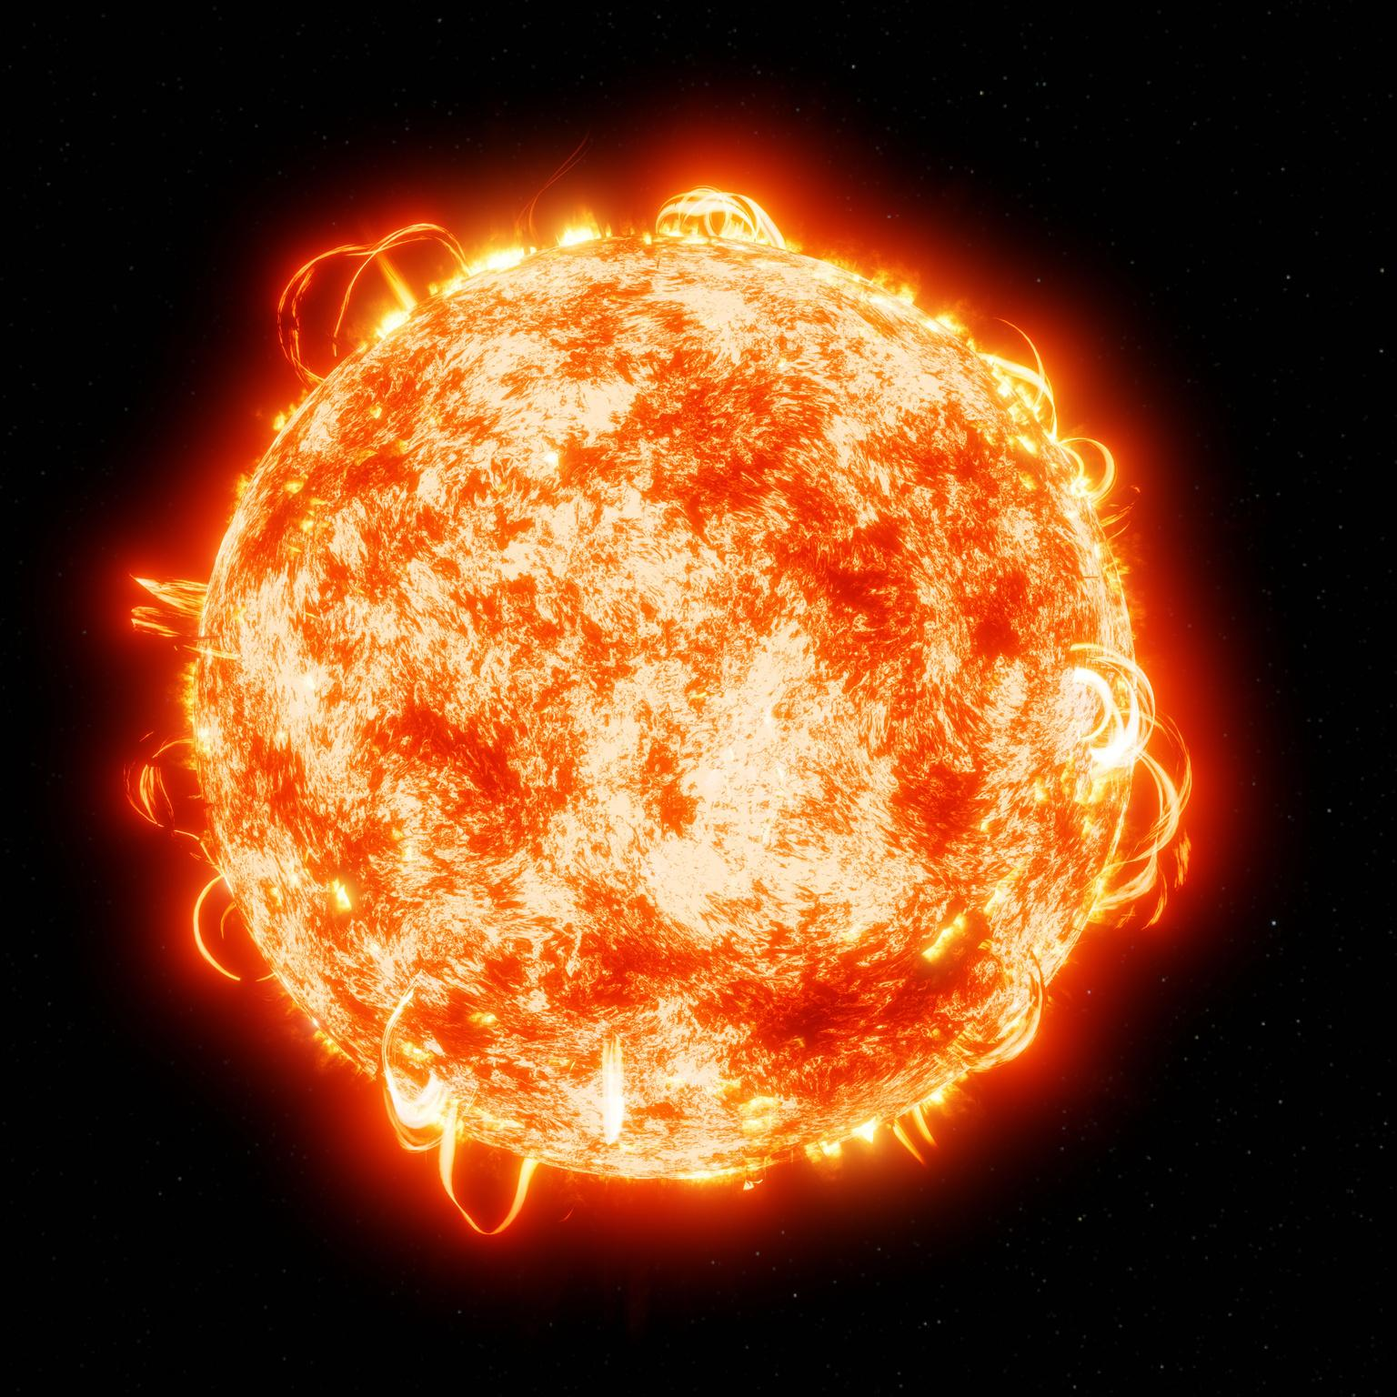

Meet the Sun
  The Sun is a giant star made mostly of hydrogen and helium.
  It’s over 4.5 billion years old.
  Energy comes from nuclear fusion (atoms of hydrogen smash together to make helium, releasing energy).

Slide 3

Sun and Energy
  Energy travels as light and heat.
  Different types of energy:
    Visible light (what we see 🌈)
    Infrared (feels warm 🔥)
    Ultraviolet (UV) rays (invisible but powerful ⚡)

Slide 4
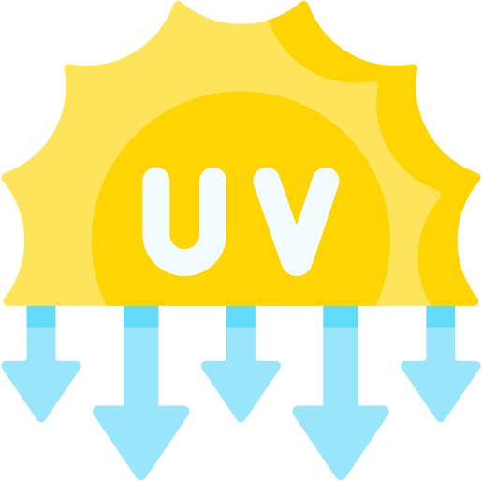
What are UV Rays?
  “Ultraviolet” = beyond violet light (can’t see it).
  Types:
    UVA → ages skin (wrinkles)
    UVB → burns skin (sunburn)
    UVC → blocked by the atmosphere!

Slide 5
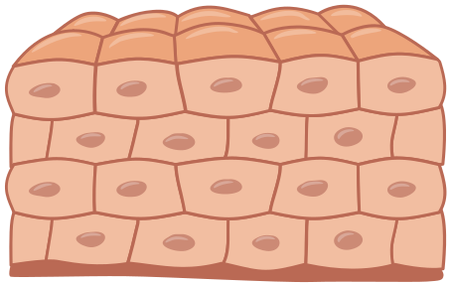
UV Rays Affect Skin
  Skin cells contain DNA (instructions for cells).
  Too much UV = DNA damage.
  DNA damage can cause:
    Sunburn 🔴
    Aging lines and spots
    Skin cancer

Slide 6

Why YOU are at Risk
  Kids’ skin is thinner and more sensitive.
  Sunburns in childhood = higher cancer risk later.
  Protection habits started young = big payoff as adults.

Slide 7

Prevention Tips
  Daily Habits
  UV Index
  Clothing Protection
  Timing & Location
  Sunscreen Hacks
    Sports
    Long-Term Protection

Slide 8
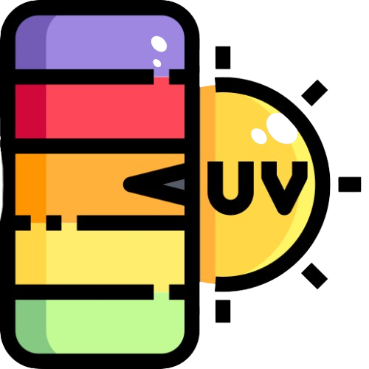
Daily Habits
  Check the UV Index each morning (apps or weather sites). If it’s 3 or higher, sun protection is needed.
  Apply sunscreen as part of your morning routine (like brushing teeth).
  Keep a small bottle of sunscreen in your backpack or sports bag.

Slide 9
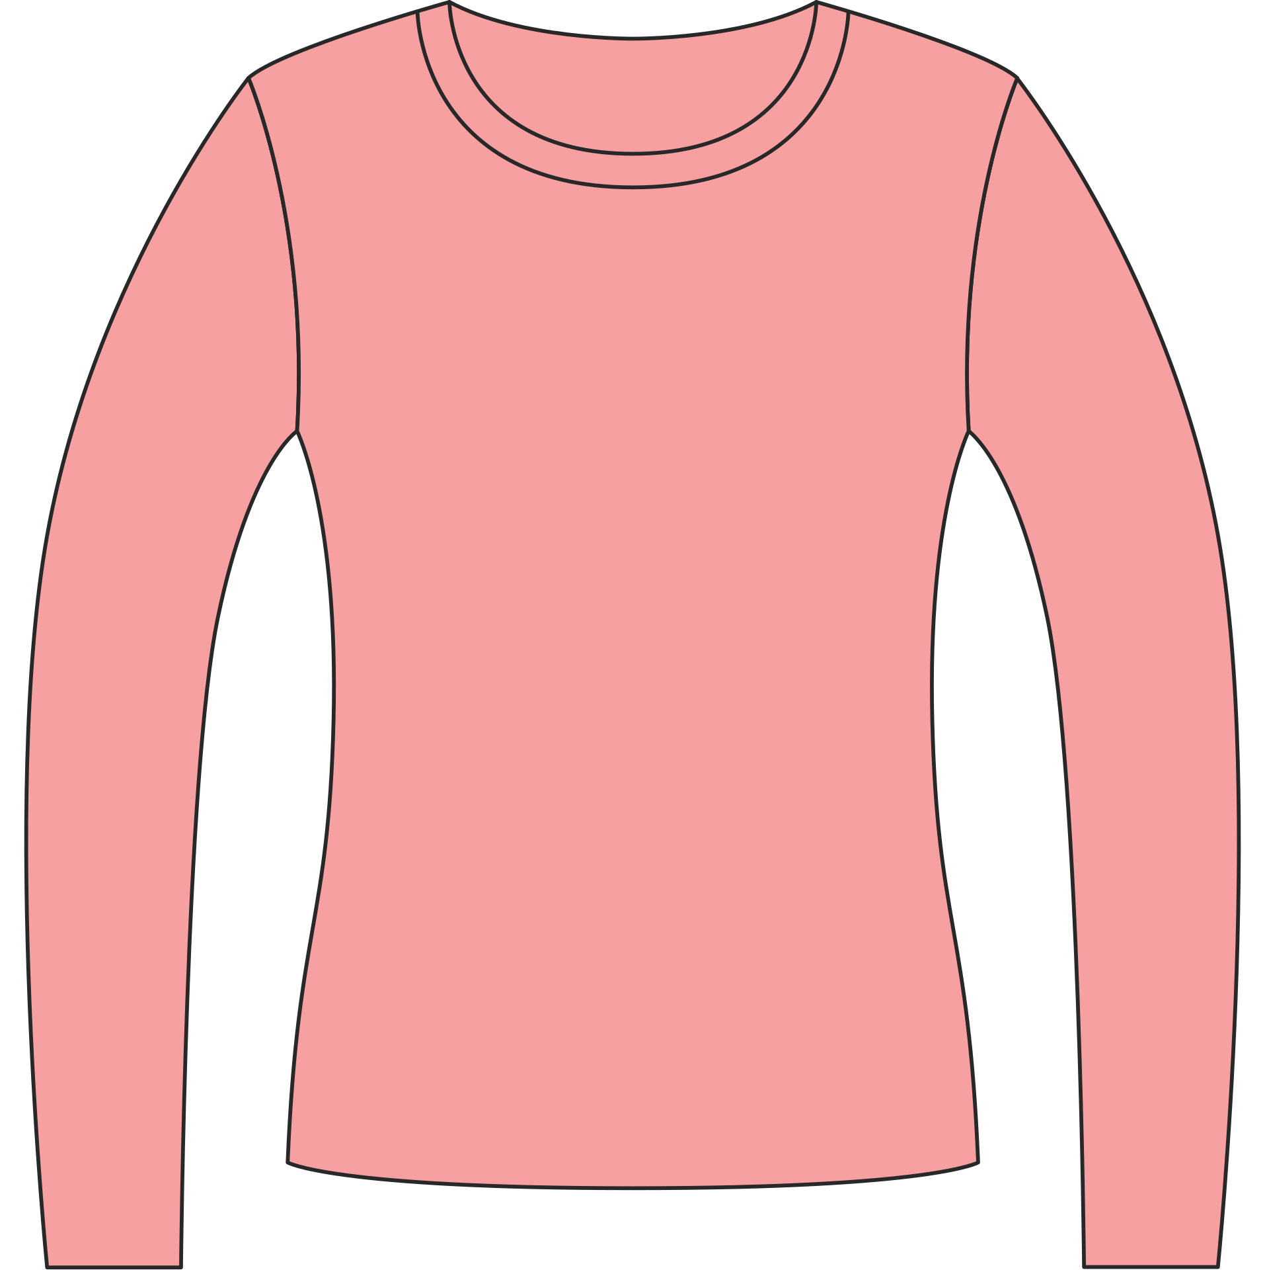

Clothing Protection
  Wear long sleeves, pants, or rash guards when outside for long periods.
  Look for clothes with UPF (Ultraviolet Protection Factor) labels.
  Pick wide-brimmed hats (not just baseball caps) to protect the neck and ears.

Slide 10
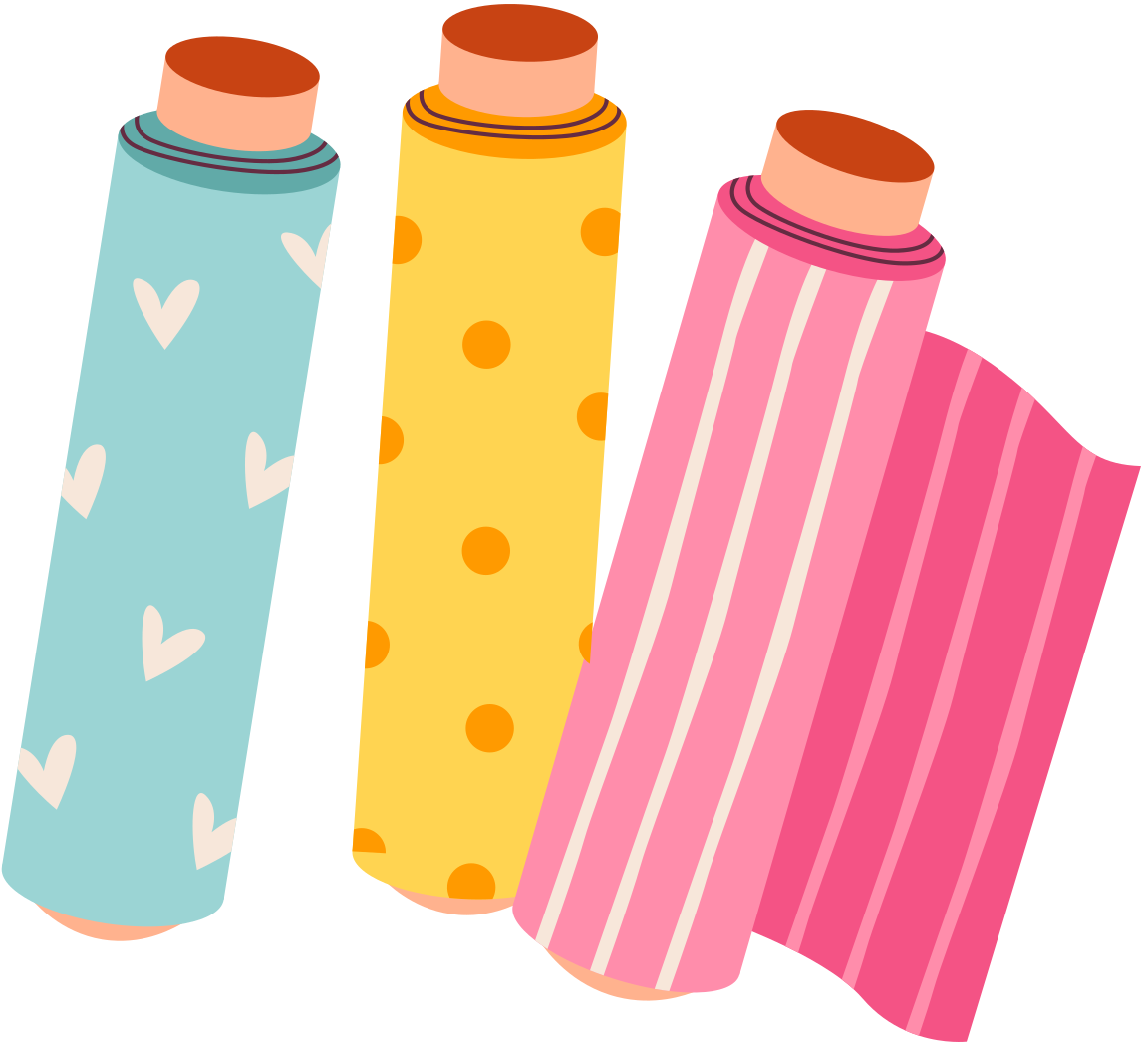
Clothing Science
  Darker colors absorb more UV, lighter colors reflect some.
  Tightly woven fabrics block rays better.
  Shade can lower UV, but reflections from sand/water/snow can still burn you!

Slide 11

Timing and Location
  Play outside in the morning (before 10am) or afternoon (after 4pm), when UV rays are weaker.
  Use umbrellas or pop-up tents for shade at the beach, park, or sports fields.
  Avoid concrete or water reflections during peak hours (they bounce UV rays back at you).

Slide 12
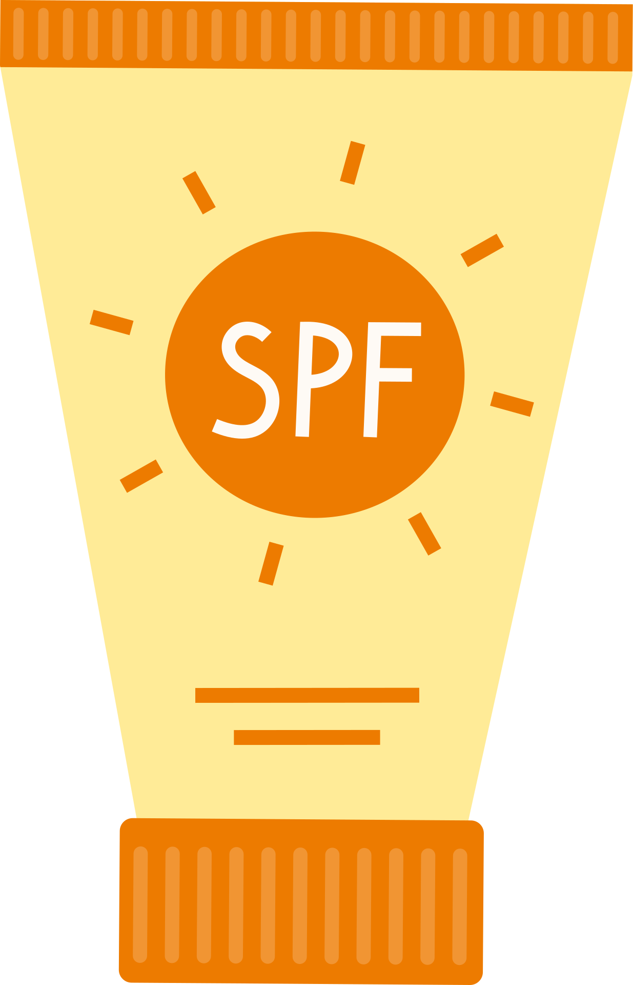
Sunscreen Hacks
  Use a stick sunscreen for the face, ears, and around the eyes (less stingy).
  Spray sunscreen is quick coverage but rub it in.
  Don’t forget “hidden spots”:
    scalp, hair, neck
    tops of feet
    lips (use SPF lip balm)

Slide 13

Outdoor Activities
  Reapply sunscreen every 2 hours, or every 40-80 minutes if swimming/sweating (check label).
  Use water-resistant formulas for swimming, soccer, or tennis.
  Keep a cooling towel + sunscreen kit for hot days.

Slide 14
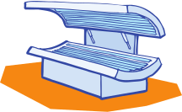
Long-Term Protection
  Never use tanning beds (way more dangerous than the sun).
  See a dermatologist if a mole or spot changes.
  Parents: teach kids to do a “skin check” with you once a month.

Slide 15

Fun Sun Facts
  The sun is so big, 1 million Earths could fit inside it!
  Light from the sun takes 8 minutes to reach Earth.
  Even on cloudy days, up to 80% of UV rays get through.

Slide 16
Thank you!

